Slide 1
DevOps Lab
Varun khare
M.SC. STATISTISCS, M.TECH. CSE ( NIT JAIPUR )

Slide 2
Maven
Maven is a powerful build automation and project management tool primarily used for Java projects. It simplifies the build process by:
• Enforcing a standard project structure (convention over configuration).
• Managing dependencies automatically by downloading them from remote repositories (e.g., Maven Central, Maven Central is a big online library where Maven automatically downloads the required Java libraries for your project.).
• Defining a clear build lifecycle (compile, test, package, install, deploy).
• Allowing the integration of various plugins to extend functionality (e.g., testing,
reporting)

Slide 3
Commands :
mvn archetype:generate -DgroupId=com.example -DartifactId=MyMavenApp -DarchetypeArtifactId=maven-archetype-quickstart -DinteractiveMode=false
Note : You will have to add plugins in POM file for compiling and running class file, hence final POM file is uploaded in GCR
2. mvn compile
3. mvn test
4. mvn package
5. mvn clean

Slide 4
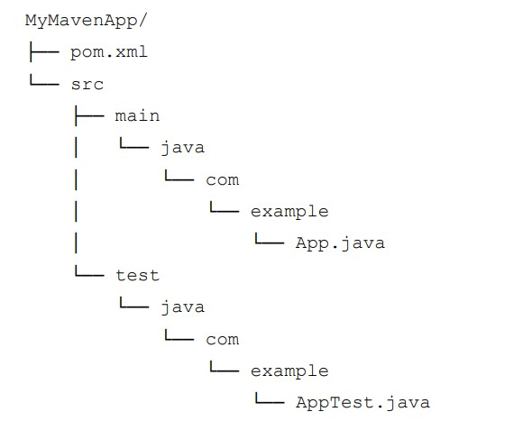
After generating the project, you will notice the following standard Maven directory structure:

